Slide 1
Numerical Analysis of Chaos in Lagrangian Systems
Jessie Wu
Ph 235
Spring 2017

Slide 2
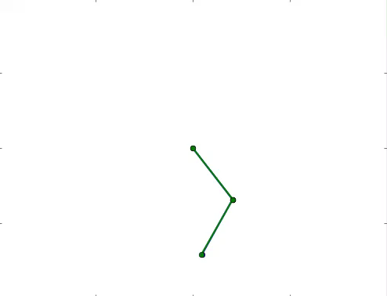
Chaos
Behavior of deterministic systems that are highly sensitive to initial conditions
Double Pendulums are a classic example
Notes:
Chaos: infinitesimal (extremely small) difference in initial conditions lead to large differences in state in small amount of time
Errors grow exponentially in time

Slide 3
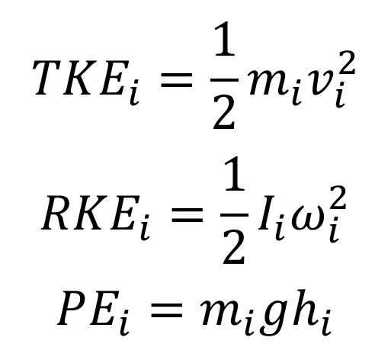
Problem Statement
Characterize the dynamics of this specific triple pendulum
$$TKE_{i}=\frac{1}{2}m_{i}v_{i}^{2}$$
$$RKE_{i}=\frac{1}{2}I_{i}ω_{i}^{2}$$
$$PE_{i}=m_{i}gh_{i}$$
Gravity, m/s² | 9.8
Length, m | 0.4
Mass, kg | 1.0

Slide 4
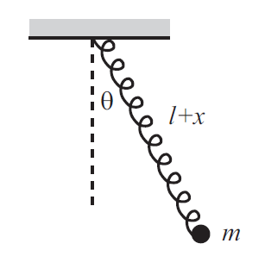
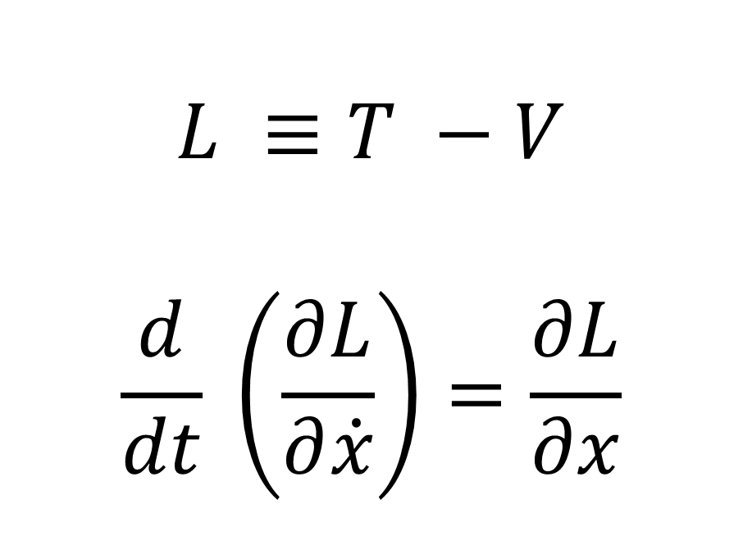
Lagrangian Method
Case Study: Pendulum Spring
$$L ≡T −V$$
$$\frac{d}{dt} \left(\frac{∂L}{∂\dot{x}}\right)=\frac{∂L}{∂x}$$

Slide 5
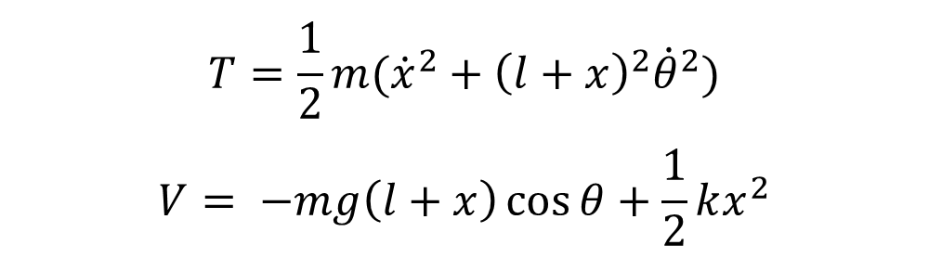
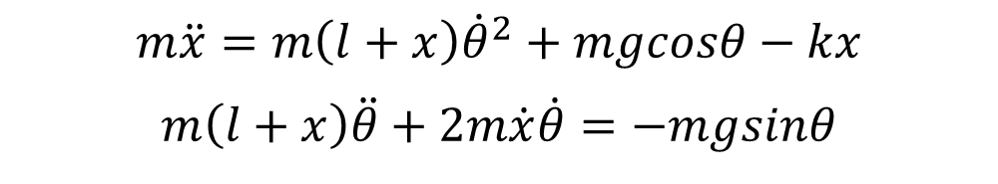
Lagrangian Method
$$T=\frac{1}{2}m({\dot{x}}^{2}+{\left(l+x\right)}^{2}{\dot{θ}}^{2})$$
$$V= −mg\left(l+x\right)\cos{θ}+\frac{1}{2}kx^{2}$$
Take Derivatives
$$m\ddot{x}=m\left(l+x\right){\dot{θ}}^{2}+mgcosθ−kx$$
$$m\left(l+x\right)\ddot{θ}+2m\dot{x}\dot{θ}=−mgsinθ$$

Slide 6
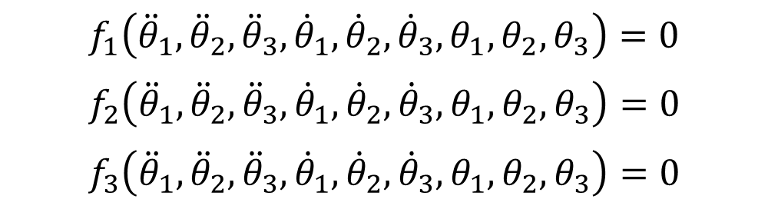


Runge Kutta 4th Order Algorithm
$$f_{1}\left({\ddot{θ}}_{1},{\ddot{θ}}_{2},{\ddot{θ}}_{3},{\dot{θ}}_{1},{\dot{θ}}_{2},{\dot{θ}}_{3},θ_{1},θ_{2},θ_{3}\right)=0$$
$$f_{2}\left({\ddot{θ}}_{1},{\ddot{θ}}_{2},{\ddot{θ}}_{3},{\dot{θ}}_{1},{\dot{θ}}_{2},{\dot{θ}}_{3},θ_{1},θ_{2},θ_{3}\right)=0$$
$$f_{3}\left({\ddot{θ}}_{1},{\ddot{θ}}_{2},{\ddot{θ}}_{3},{\dot{θ}}_{1},{\dot{θ}}_{2},{\dot{θ}}_{3},θ_{1},θ_{2},θ_{3}\right)=0$$
. . .
$$y_{1}= {\dot{θ}}_{1}$$
$$y_{2}= {\dot{θ}}_{2}$$
$$y_{3}= {\dot{θ}}_{3}$$
$$\dot{y_{1}}=f(y_{1},θ)$$
$$\dot{y_{2}}=f(y_{2},θ)$$
$$\dot{y_{3}}=f(y_{3},θ)$$

Slide 7
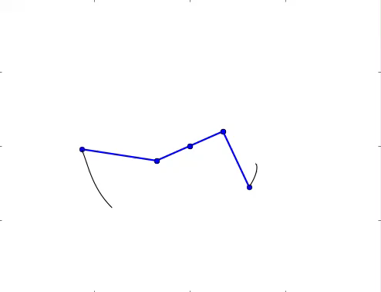
Animation and Plot

Slide 8
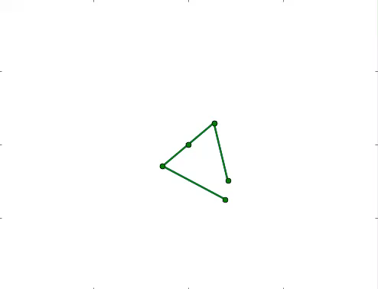
Animation and Plot

Slide 9
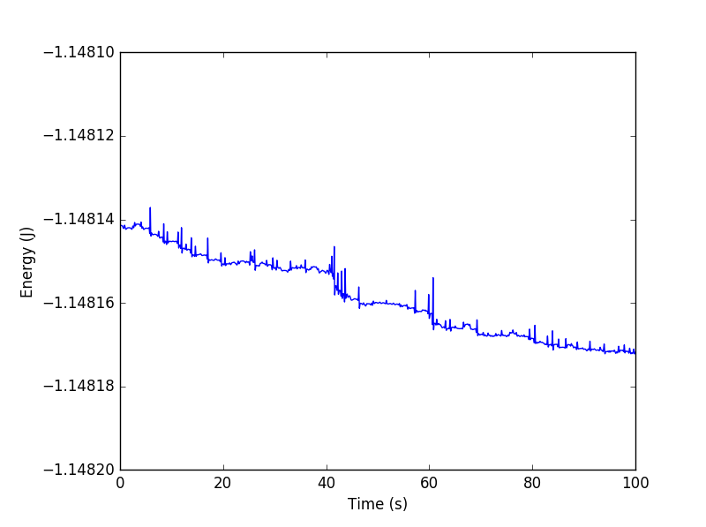
Animation and Plot
Energy Over Time (Joules)
Max Difference: 3.5e-05

Slide 10
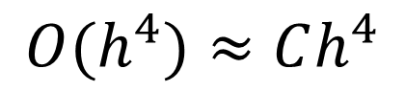
Checking for Error
$$O(h^{4})≈Ch^{4}$$

Slide 11
Solution Process
Determine Constants and Langrangian (Energy)
Take Derivatives to Find Equations of Motion
Run RK4 Algorithm to Determine Numerical Solution
Convert from Angles to Coordinates
Plot and Animate Results

Slide 12
Solution Process
Determine Constants and Langrangian (Energy)
Take Derivatives to Find Equations of Motion
Run RK4 Algorithm to Determine Numerical Solution
Convert from Angles to Coordinates
Plot and Animate Results

Slide 13
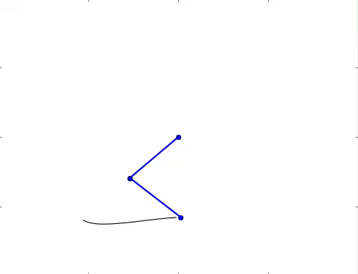
Additional Systems: Double Pendulum

Slide 14

Additional Systems: Spring Pendulum

Slide 15
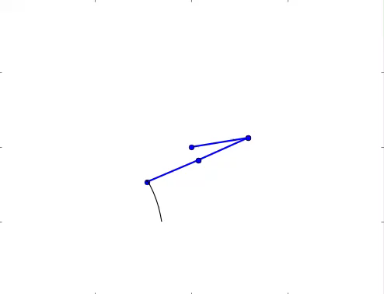
Additional Systems: Linked Triple Pendulum

Slide 16
Lyapunov Exponent¹
Characterizes rate of separation of infinitesimally close trajectories
Diagnostic for chaotic systems
Lyapunov Exponent
Triple Pendulum | 3.06
Double Pendulum | 3.65
Triple Pendulum, Linked | 3.49
Spring Pendulum | 0.27
(1) Determining Lyapunov Exponents From a Time Series. Alan Wolf, Jack B. Swift, Harry L. Swinney, John A. Vastano. Physica 16D, p.285-317 (1985).

Slide 17
Questions?

